Slide 1
OHLCV on BTCUSDT

Slide 2
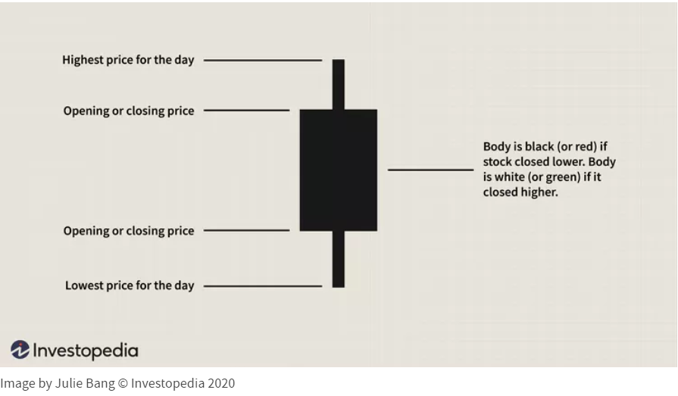
OHLCV BTCUSDT?
Open
High
Low
Close
Volume - how many bitcoins were bought and sold
Bitcoin-USDT data from bitfinex exchange

Slide 3
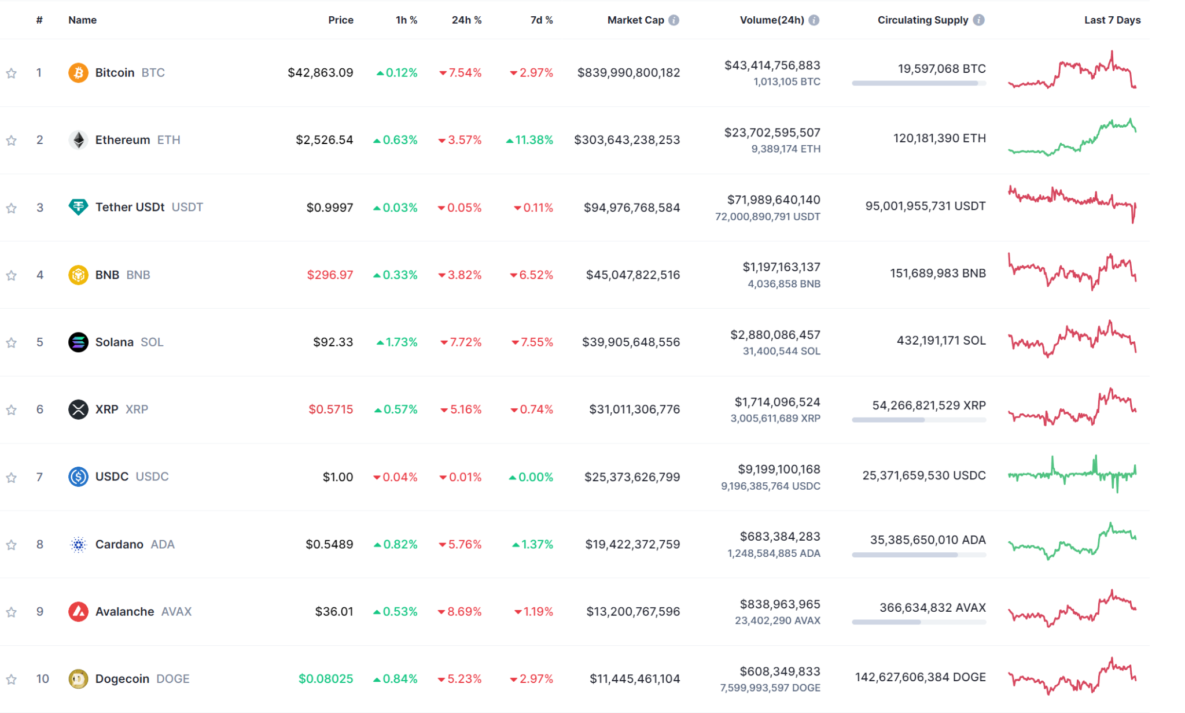
Many currencies
ADA
XRP
ETH
BNB

Slide 4
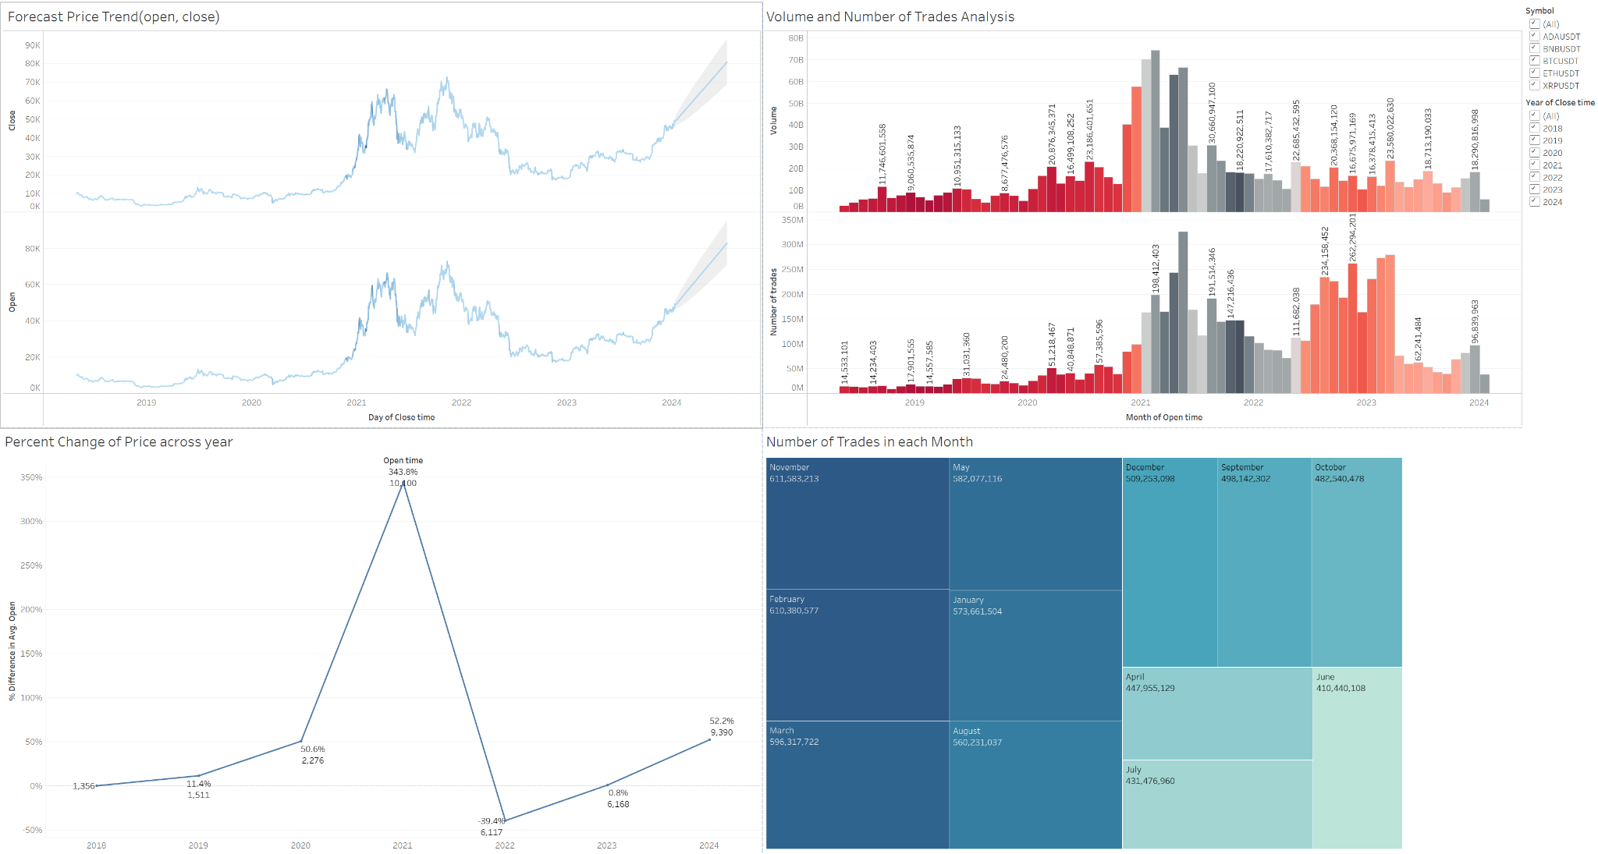
Outlook
Overall trend is low
Seems to be climbing
Most trades in November

Slide 5
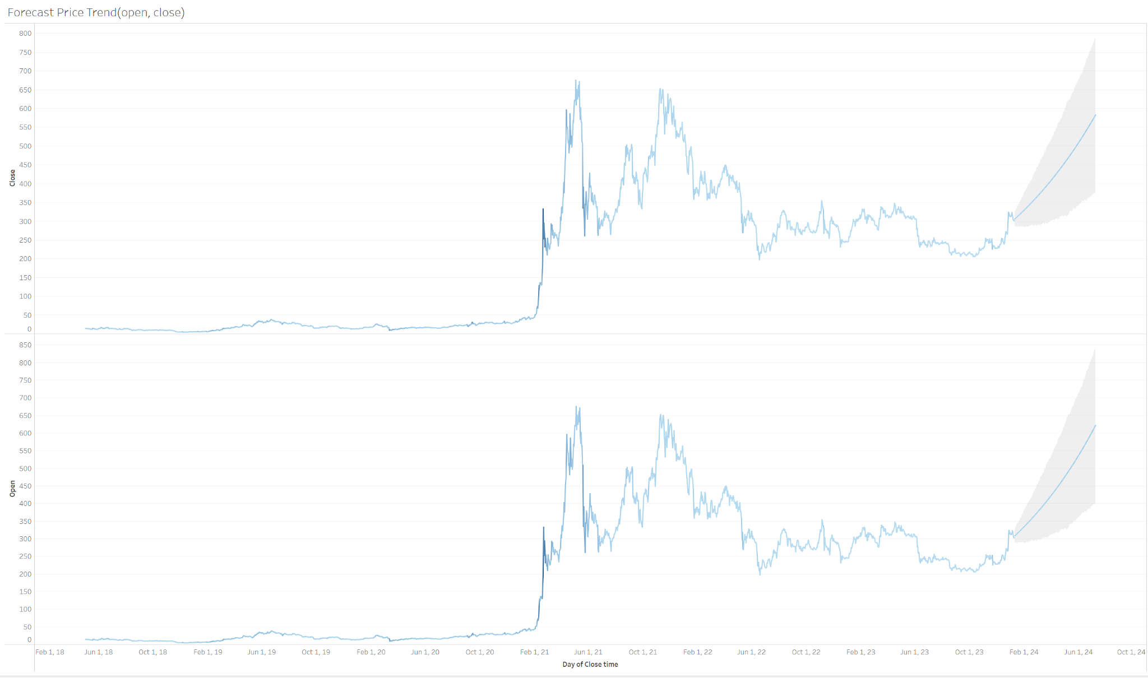
BNB
Price

Slide 6
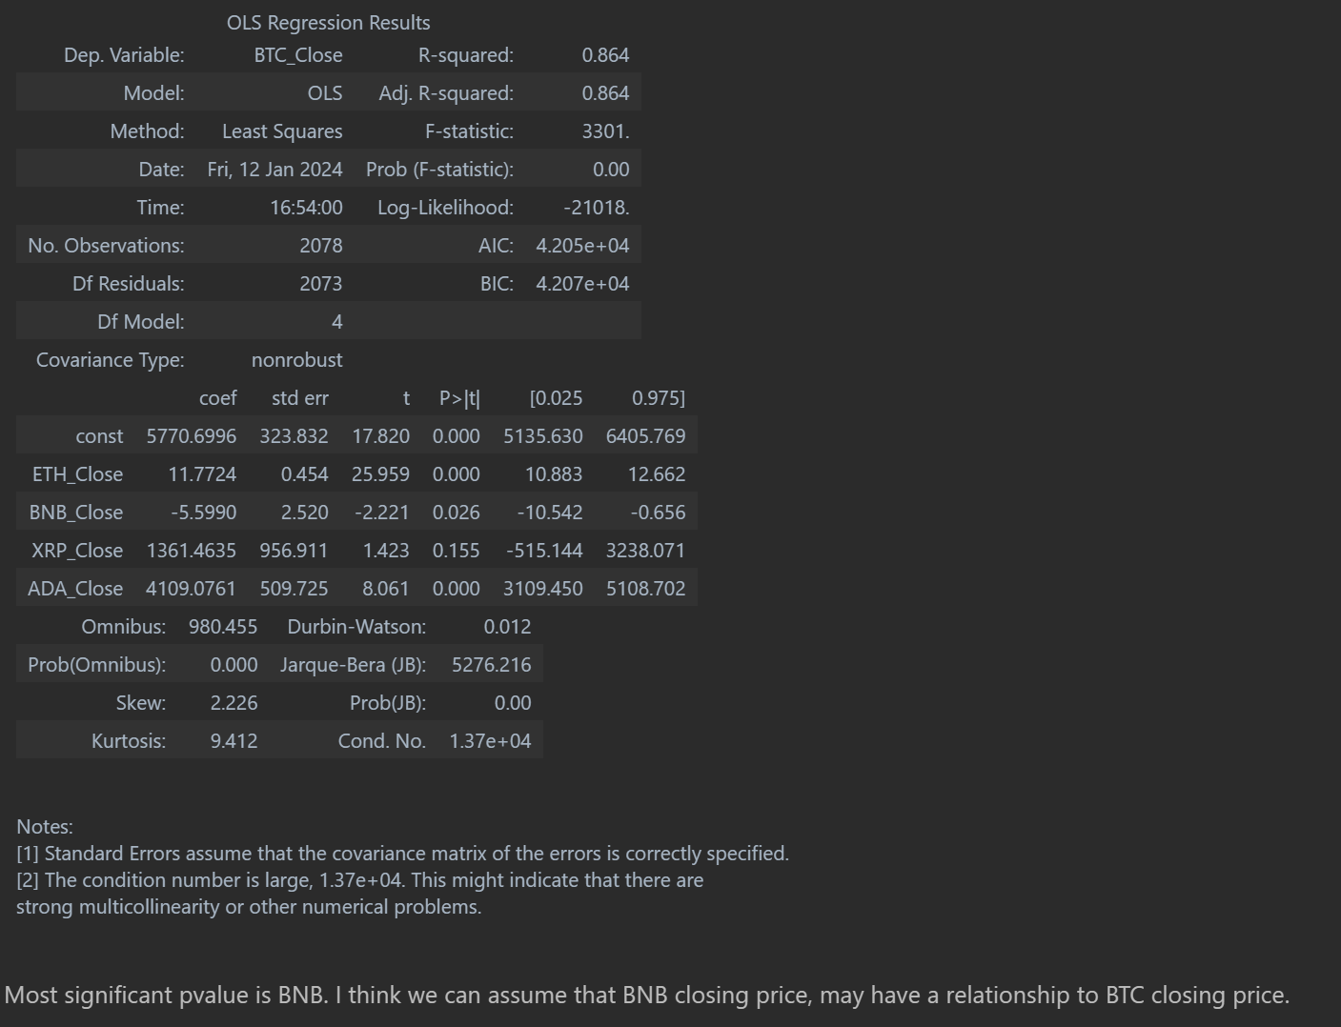
BTC BNB
Had significant p value to start exploring with
Out of all the coins…
BNB close and BTC close, we can start exploring

